Slide 1
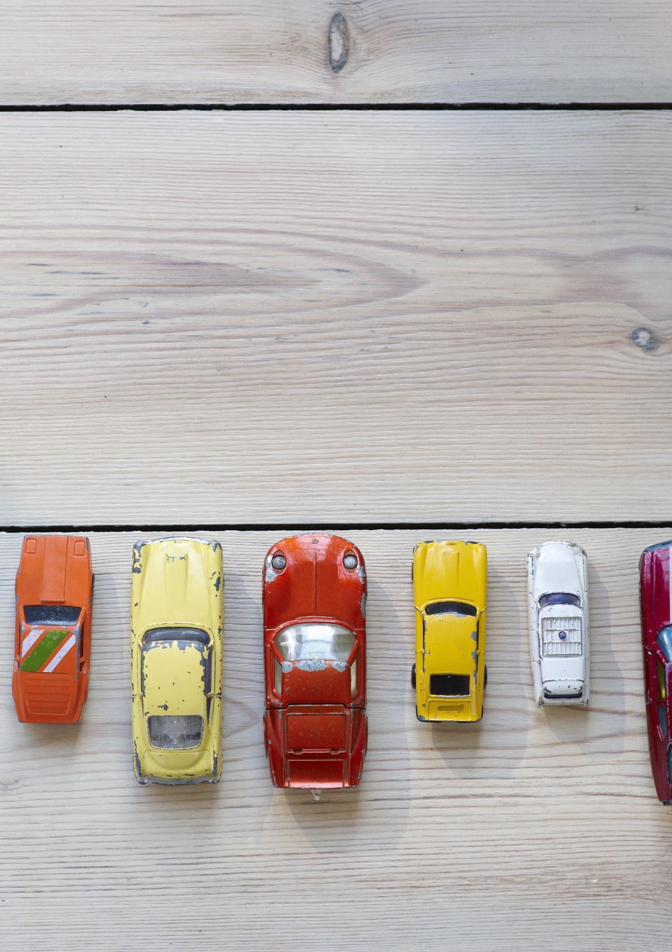
Car Price Prediction
Submitted to: Eng. Abdallah Wagih Ibrahim
Sumbitted by :
1- Amir Ashraf
2-Jana Hisham
3-John Nageh
4-Peter Hossam

Slide 2
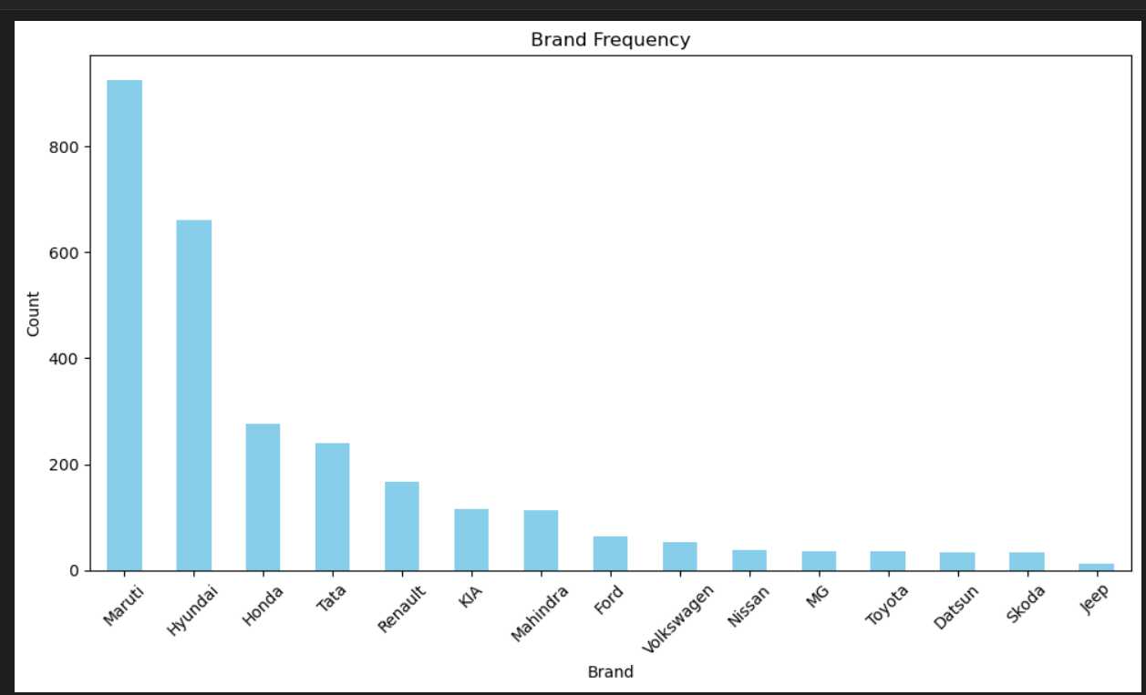
Univariate Analysis
This is a univariate analysis of the 'Brand' variable, represented through a bar plot. It shows the frequency of each car brand in the dataset.
The dataset is heavily dominated by Maruti and Hyundai, indicating a strong preference or higher availability of these brands compared to others like Jeep, Skoda, and Datsun, which have minimal presence

Slide 3
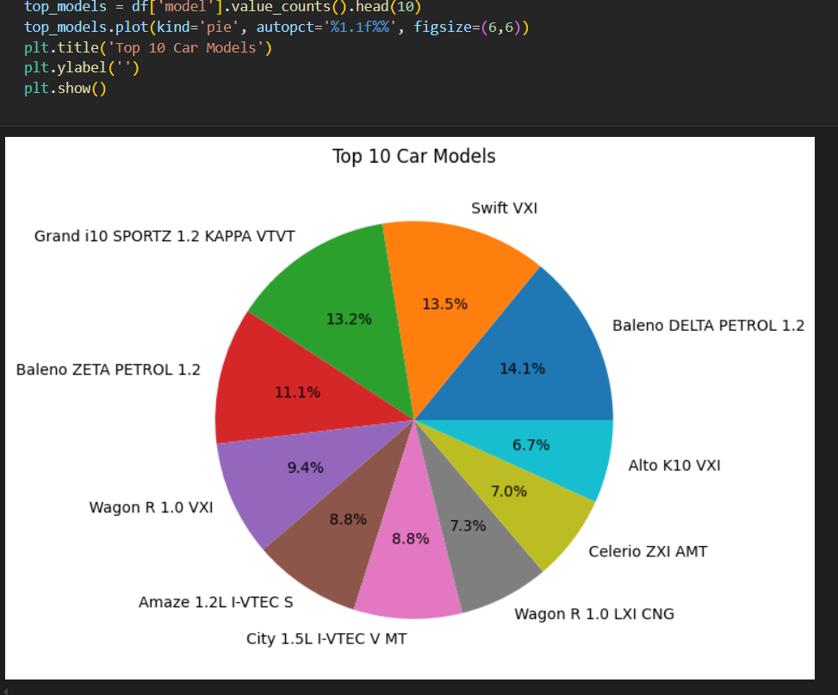
The top 3 car models—Baleno DELTA, Swift VXI, and Grand i10 SPORTZ—dominate the list, together making up over 40% of the top 10.

Slide 4
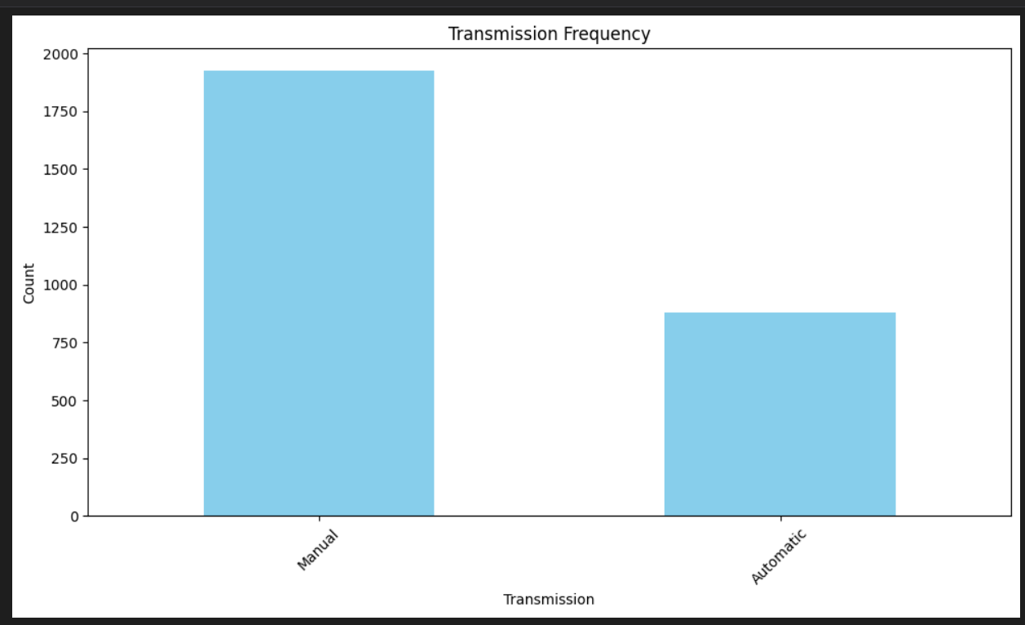
This univariate analysis shows that manual transmission cars are more than twice as common as automatic ones in the dataset, indicating a strong market preference or availability for manual vehicles.

Slide 5
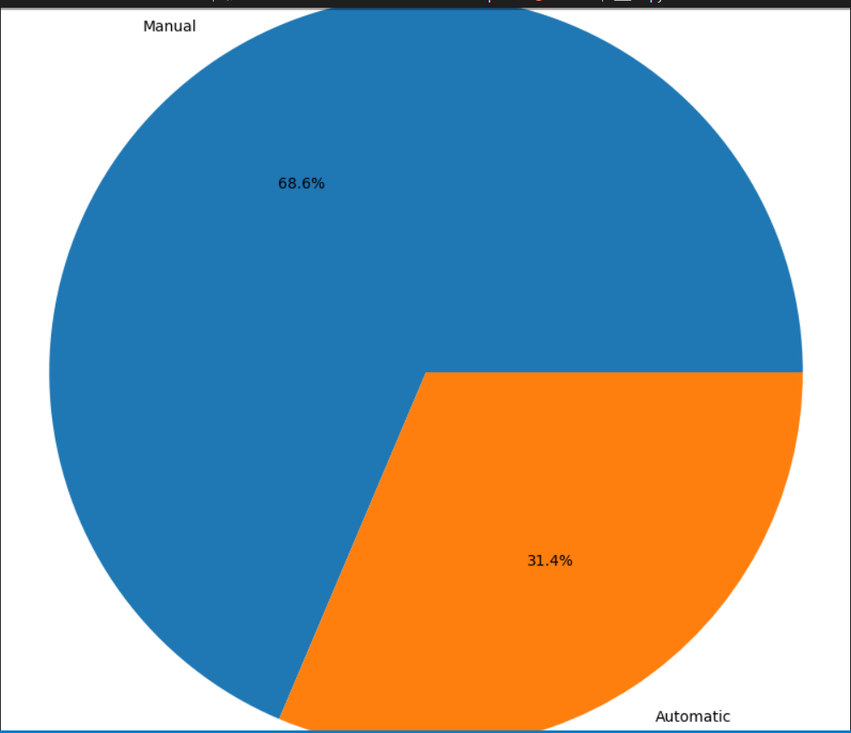
This pie chart shows that 68.6% of the cars have manual transmission, while 31.4% are automatic,reinforcing that manual cars are more than twice as common in the dataset.

Slide 6
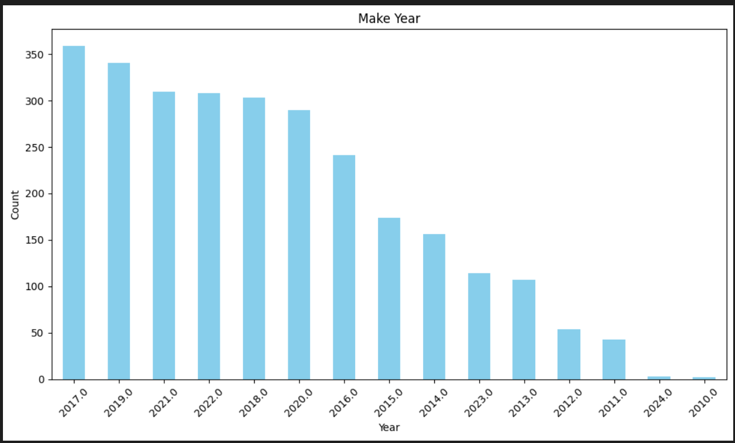
The graph shows that most cars were manufactured between 2016 and 2022, with a steady decline in older cars, indicating a preference for newer models.

Slide 7
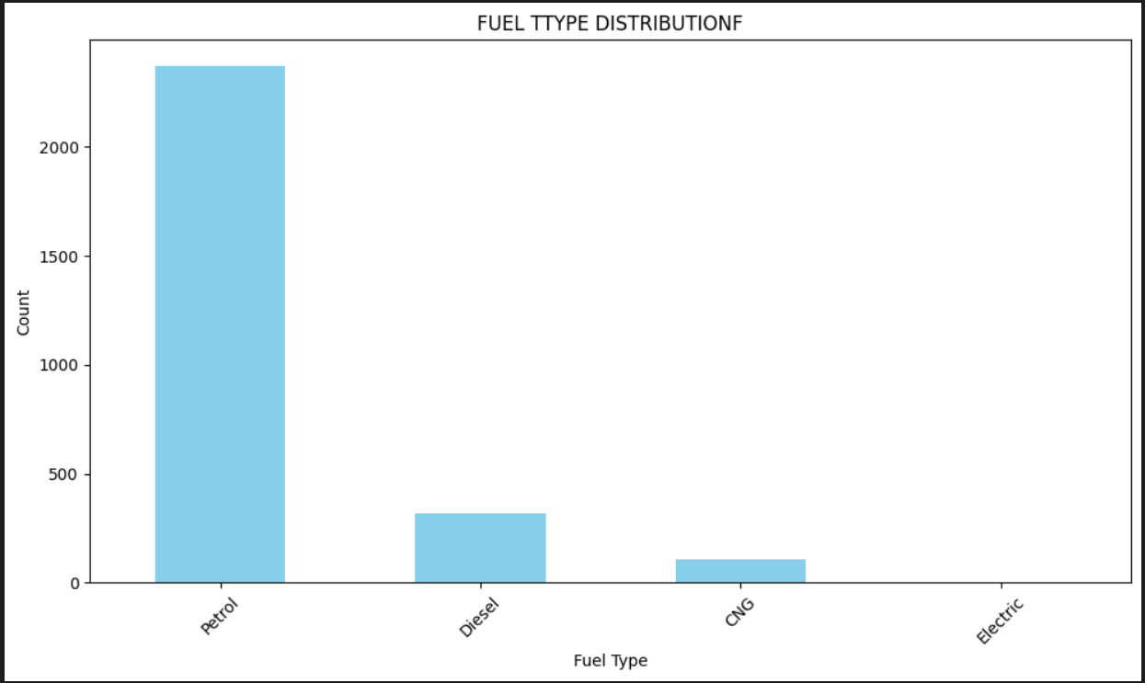
Petrol is the most used fuel type, while electric cars are extremely rare in the dataset.

Slide 8
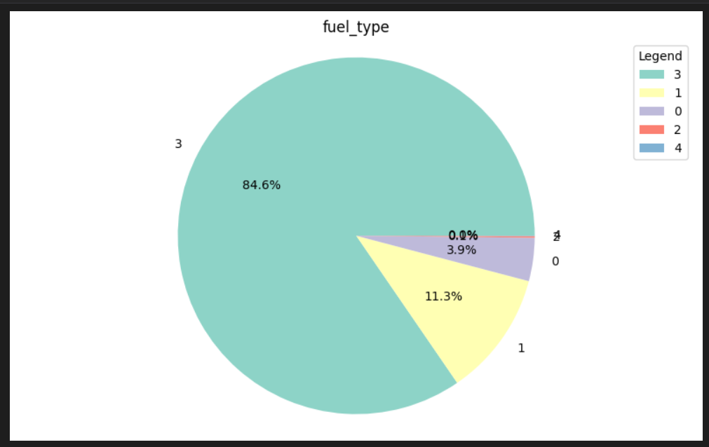
The data is heavily skewed towards one fuel type (label 3), with very few entries for other types. If label 3 corresponds to "Petrol" as in previous charts, this confirms petrol vehicles dominate the dataset.

Slide 9
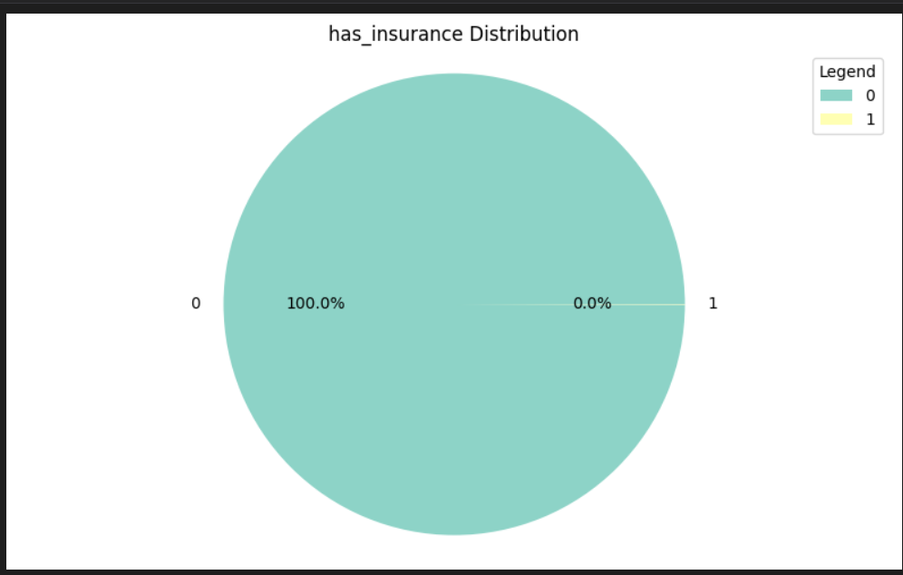
This pie chart shows that 100% of the vehicles do not have insurance (has_insurance = 0), and 0% have insurance (has_insurance = 1).

Slide 10
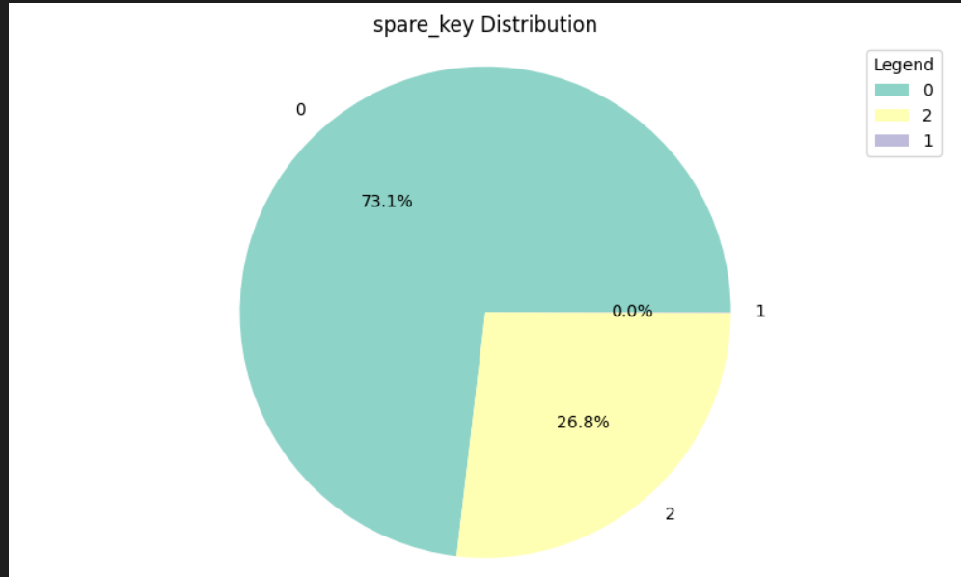
Most vehicles run on petrol (84.6%) and lack spare keys (73.1%), while nearly all are uninsured (100%). Very few use diesel, CNG, or electric, and none have exactly one spare key.

Slide 11
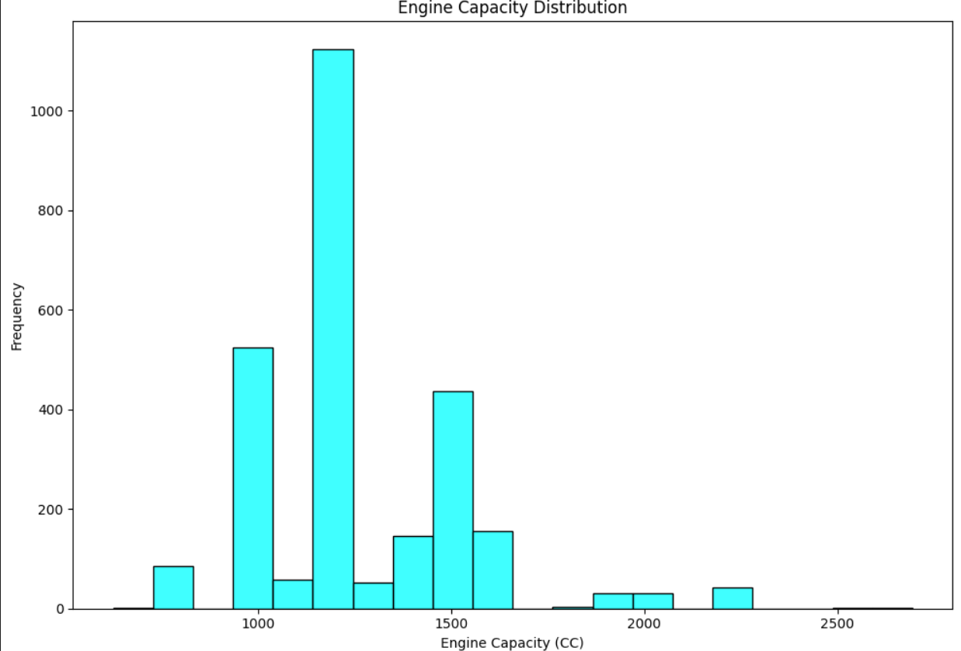
The histogram shows that most vehicles have engine capacities between 1000 CC and 1500 CC, with around 1200 CC being the most common. Engine capacities above 2000 CC are much less frequent

Slide 12
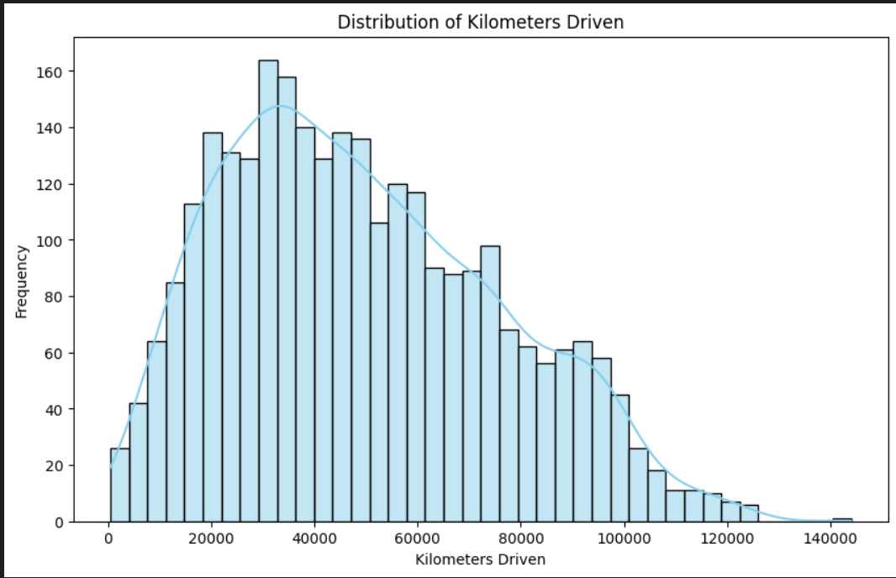
Most vehicles have been driven between 20,000 and 80,000 kilometers, with the highest frequency around 40,000 km, and fewer vehicles at very low or very high mileage.

Slide 13
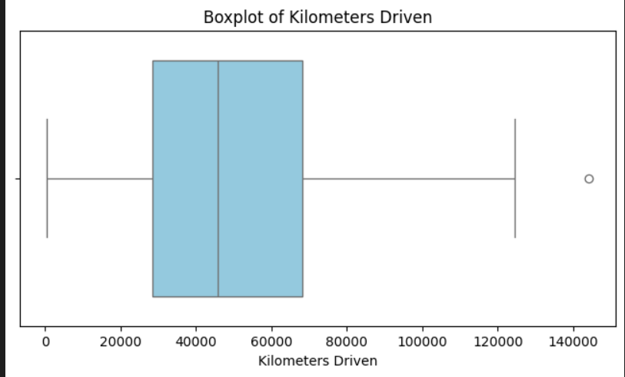
The majority of cars have been driven between 30,000 and 90,000 km, with a median around 55,000 km. There are a few outliers with mileage above 130,000 km.

Slide 14
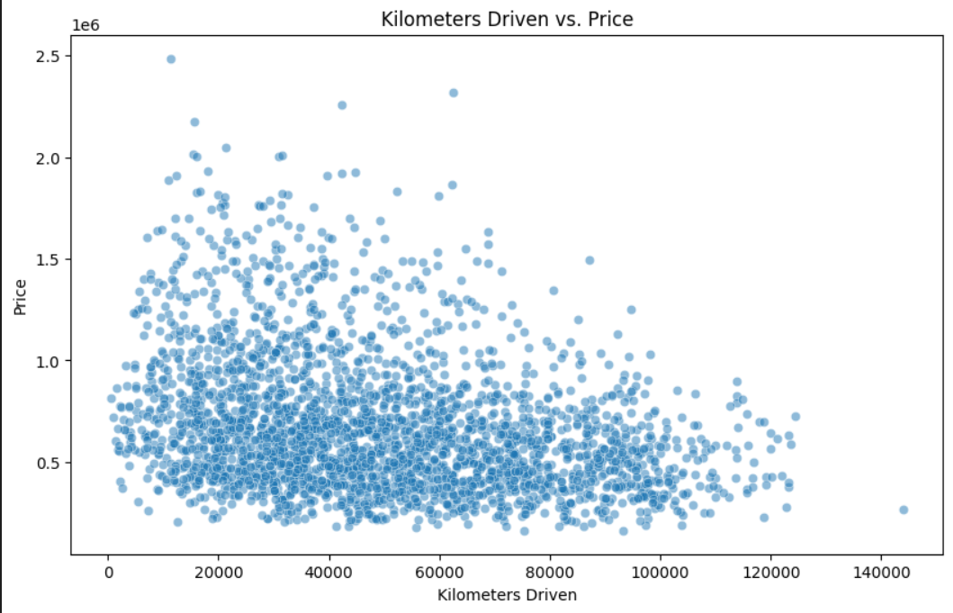
Bivariate Analysis
As the kilometers driven increases, the price generally decreases, indicating a negative correlation. However, there’s high variability, especially among lower-mileage cars, where prices range widely.

Slide 15
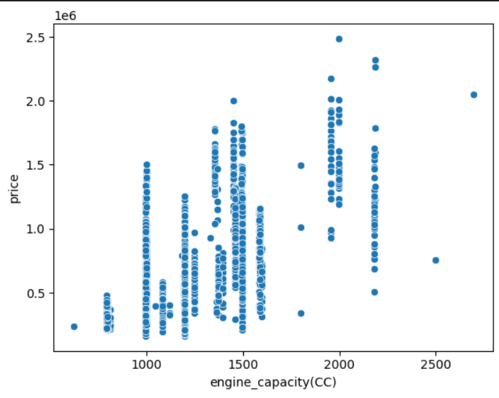
There is a positive correlation between engine capacity and price—cars with higher engine capacities generally have higher prices. However, prices vary significantly within each engine capacity group, indicating other influencing factors besides engine size.

Slide 16
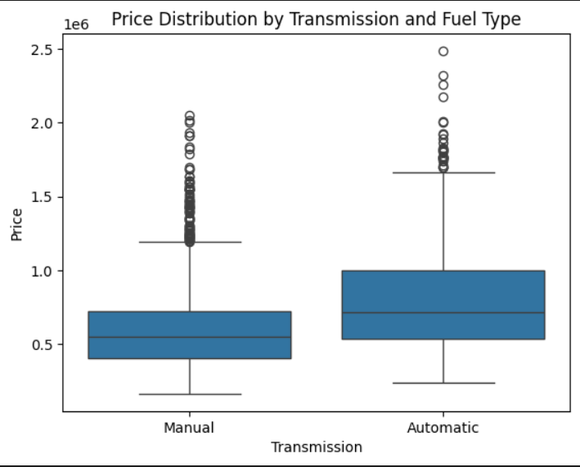
Automatic cars generally have higher prices and more variability than manual cars. The median and upper price range for automatics are both greater, with more high-end outliers.

Slide 17
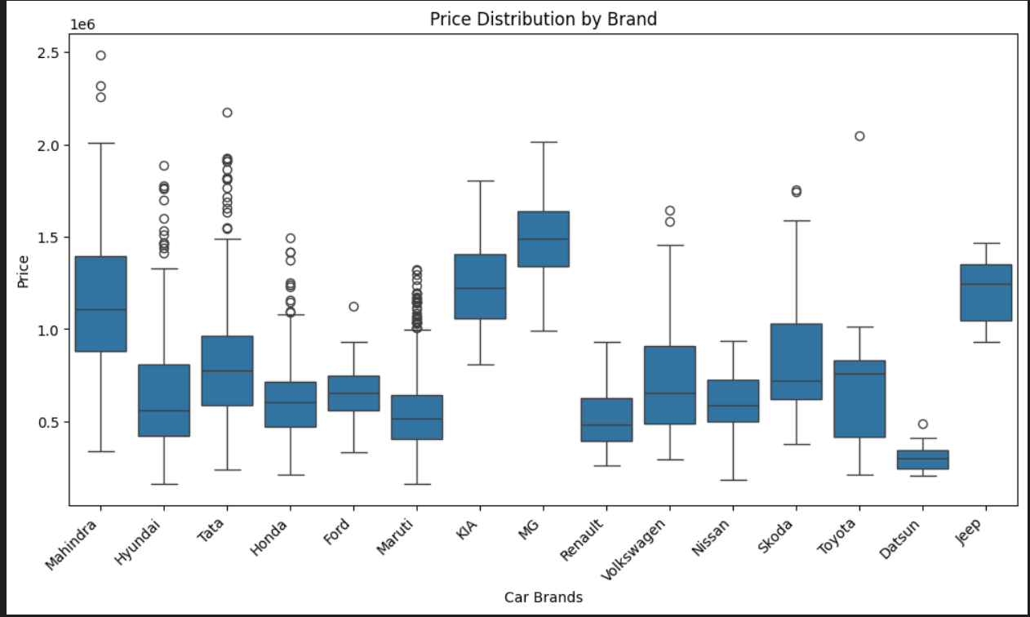
MG, Kia, and Mahindra cars have the highest median prices among the brands. Datsun has the lowest price range, while Tata and Maruti show many lower-priced outliers.

Slide 18
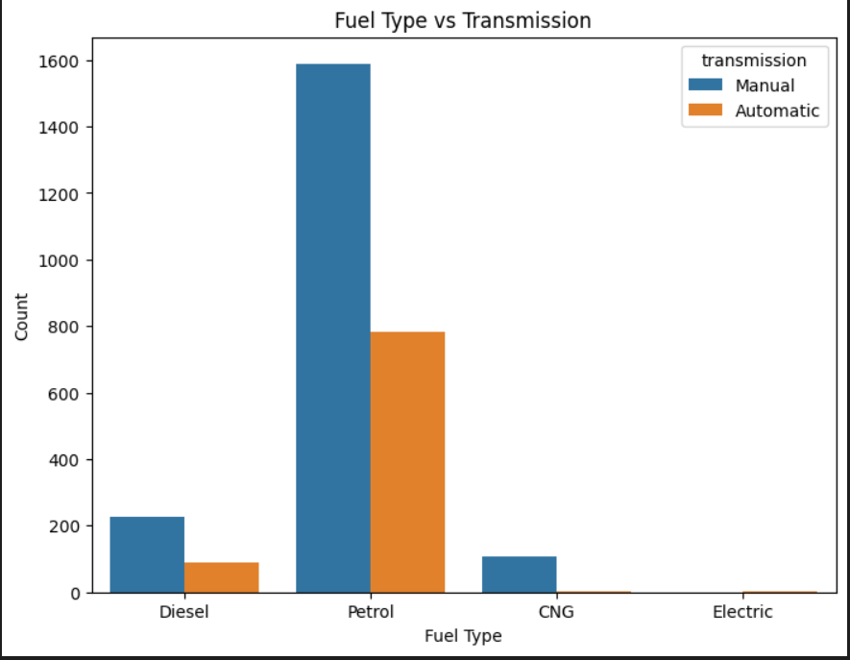
Petrol cars dominate both manual and automatic transmissions, especially manual. CNG and Electric vehicles are rarely automatic, indicating limited availability or preference.

Slide 19
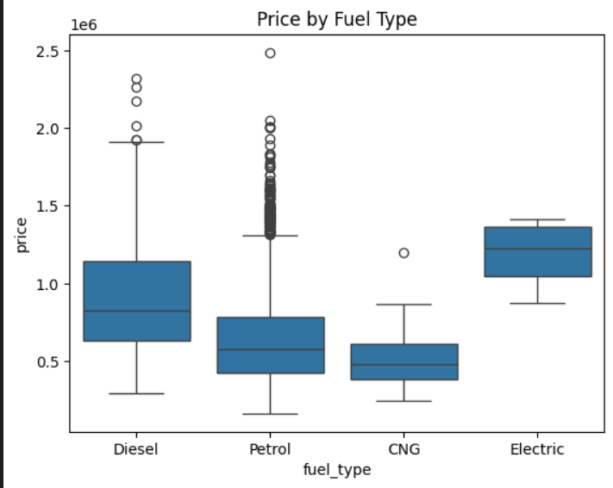
Electric vehicles have the highest median prices, followed by diesel cars. CNG and petrol cars are generally more affordable, with petrol showing a wider price range.

Slide 20
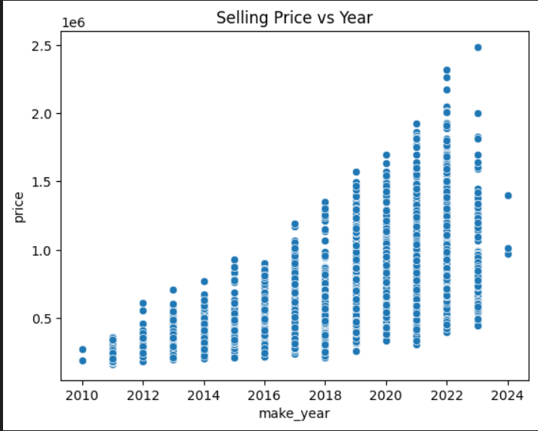
Selling price increases with newer make years, showing a strong positive correlation between car price and manufacturing year. Cars made after 2020 generally have higher prices and greater variability.

Slide 21
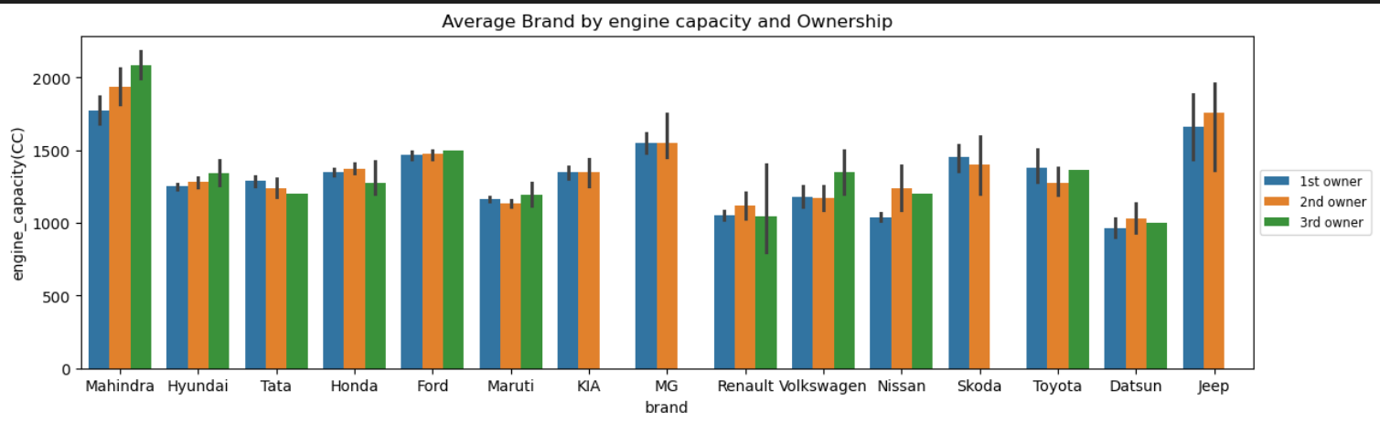
Multivariate analysis
Mahindra and Jeep cars have the biggest engines, while Maruti and Datsun have smaller ones. For most brands, engine size doesn't change much between first, second, or third owners. Some brands like MG and Volkswagen have bigger engines in cars with more owners. Cars with bigger engines are often sold and owned by more people over time.

Slide 22
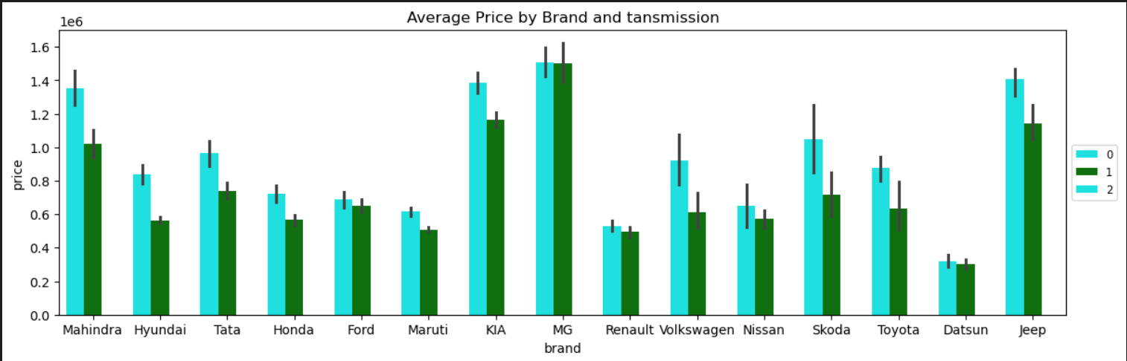
MG and Jeep have the highest average car prices, while Datsun has the lowest. Cars with transmission type "0" are generally more expensive than types "1" and "2". Most brands show clear price differences based on transmission type. This suggests both brand and transmission strongly affect car prices

Slide 23
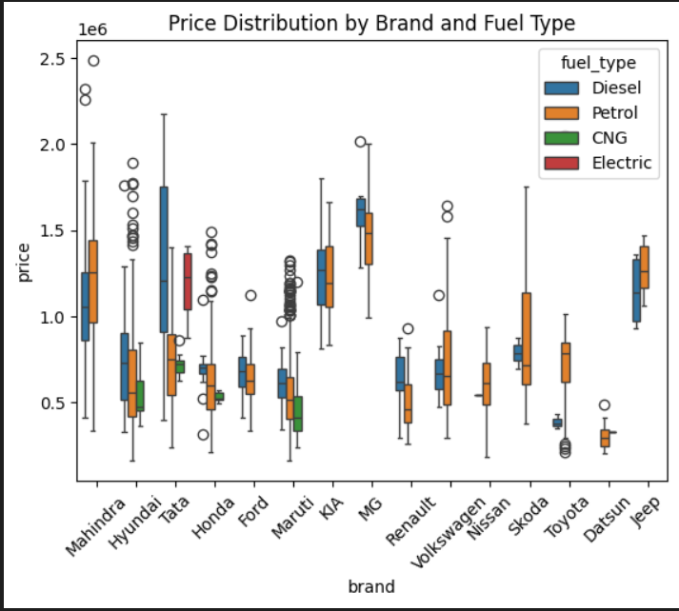
Mahindra, MG, and Jeep have high-priced diesel and petrol cars, while Maruti and Datsun offer cheaper options. CNG and electric cars are less common and usually priced mid-range. Petrol cars are widely used across all brands with varying prices. Diesel cars often have higher price ranges and more outliers

Slide 24
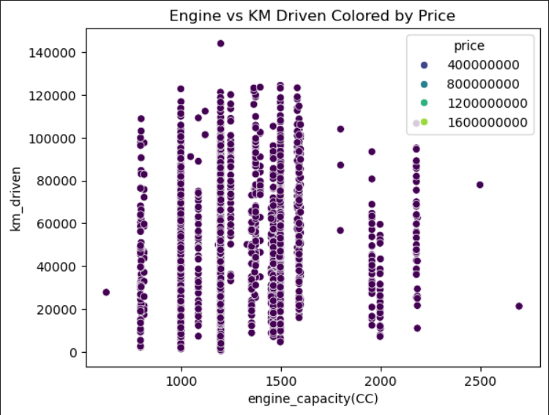
Most cars have engine capacities between 1000–1600 CC and are driven up to 1,00,000 km. There is no clear pattern between engine size, kilometers driven, and price.

Slide 25
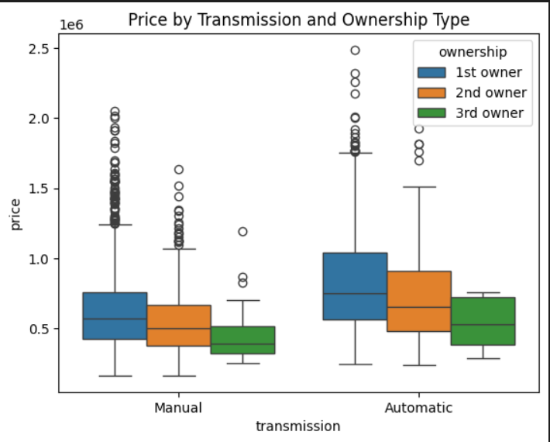
Automatic cars generally have higher prices than manual ones, especially for first owners. Prices drop for second and third owners in both transmission types

Slide 26
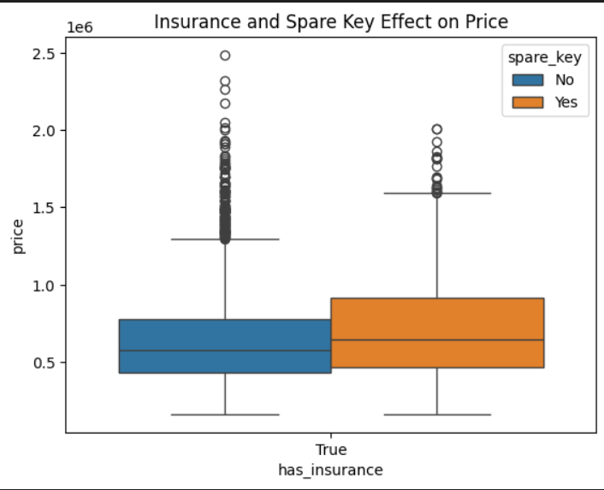
Cars with insurance and a spare key tend to have higher prices. Having both features adds value and increases buyer confidence.

Slide 27
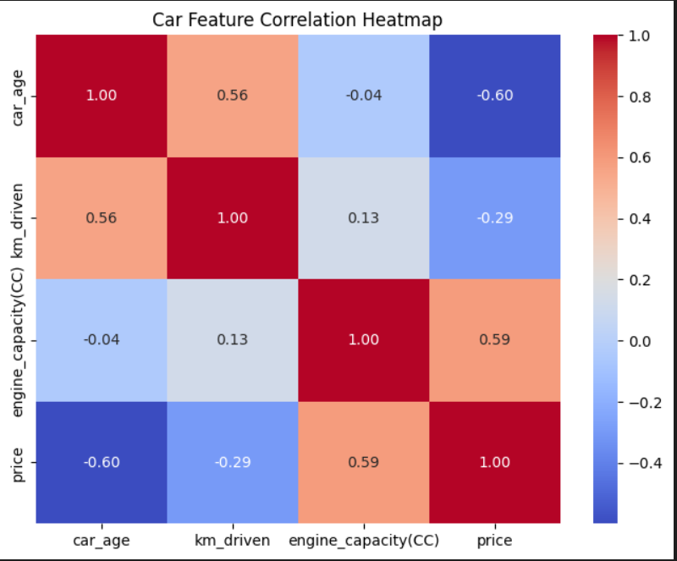
Car price increases with engine capacity but drops with age and kilometers driven. So, newer cars with bigger engines usually cost more.

